Slide 1
Capgemini India – PeopleSoft Application Designer Overview Presentation

Slide 2
Agenda
Application Designer Overview
Application Development Steps
Working with projects
Creating Field Definitions
Creating record Definitions
Understanding the Build Process
Creating Component Definitions
Creating Menu Definitions
Using the Registration Wizard
Copying Projects
Constructing File Layouts
Application Designer Implementation

Slide 3
Application Designer Overview

Slide 4
PeopleSoft Application Designer is the core development tool used to build and modify PeopleSoft applications. PeopleSoft Application Designer enables you to build a variety of definitions, including:
  Fields.
  Records (Tables).
  Pages.
  Components.
  Menus.
  PeopleCode.
  SQL.

Slide 5
Delivered Objects : Delivered by Peoplesoft
Custom Objects : New Objects created by developer
Customized Objects : Delivered by Peoplesoft, but modified to suit requirements.

Slide 6
Project workspace - Provides a graphical representation of the components that are contained in a project. The project workspace has two folder tabs:
        Development View.
        Upgrade View
Definition workspace : Displays individual definitions that you open.
Definition workspace : Contains the output text from PeopleSoft Application Designer operations, such as Build (SQL Create and Alter), Find Definition References, Upgrade, Results, Validate, and PeopleCode Log.

Slide 7
Application Designer Overview
PeopleSoft Application Designer is the core development tool used to build and modify PeopleSoft applications.
PeopleSoft Application Designer enables you to build a variety of definitions, including:
  Fields
  Records (Tables)
  Pages
  Components
  Menus
  PeopleCode
  SQL

Slide 8
Application Development Steps

Slide 9
Application Development Steps
Design the application
Create field definitions
Create record definitions
Build the application data tables
Create page definitions
Define components
Register the components
Test the application

Slide 10
Application Development Steps (cont…)
Design the application
Design the application is nothing but a development planning.
Business requirements document of the tables required and the relationships between them, a list of definitions required (fields, records, and so on) complete with detailed specifications and naming conventions, mock-ups of the page layouts, and the navigational hierarchy to give users access to the pages you create.

Slide 11
Working with projects

Slide 12
Working with projects
Project is an efficient way to organize your definitions as you develop and configure your application.
Projects can help you:
  Organize related definitions pertaining to your development under one umbrella.
  Understand relationships among definitions.
  Coordinate the work of several developers.
  Streamline upgrade tasks.
  Search for fields or records.
  Access related definitions easily.

Slide 13
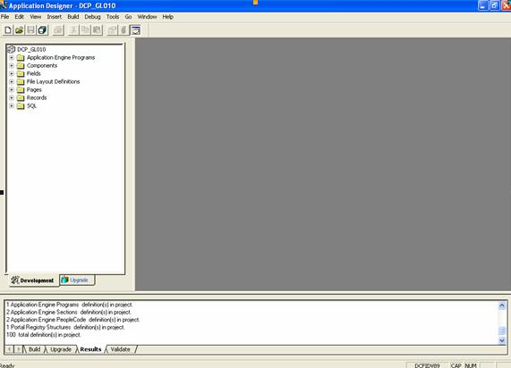
Working with projects (cont…)

Slide 14
Working with projects (cont…)
Inserting Definitions Into a Project
You can add definitions to a project by selecting Definitions into Project from the Insert menu.
When you start PeopleSoft Application Designer, an empty project titled "Untitled" always appears, whether you use the project or not. Unlike other definitions, only one project can be open at a time.
To create a new project:
  Select File, New.
  Highlight Project as the new definition type to create, and click OK
  To save a project, select File, Save Project.

Slide 15
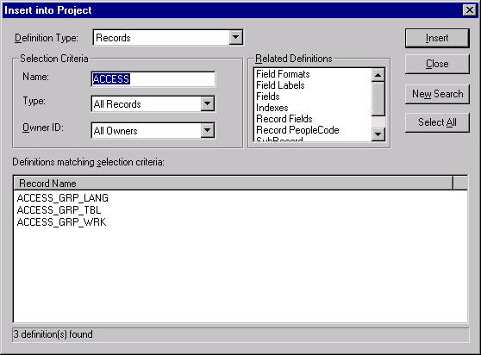
Working with projects (cont…)
Inserting Definitions Into a Project

Slide 16
Working with projects (cont…)
Removing Definitions From a Project
When you remove a definition from a project, the reference to the definition is removed from the project, but the definition still exists in the database.
Removing a definition from a project is different than deleting it from the database.
To remove definitions from a project:
  In the project workspace, select the definition that you want to remove from the project.
  Press Delete, or right-click to select Remove from Project from the pop-up menu.

Slide 17
Working with projects (cont…)
Merging Projects
You can merge two or more projects by inserting all of the definitions from one project into another.
To merge projects:
  Open the project in which you want to insert another project.
  Select File, Merge Projects.
  The Merge Projects dialog box appears.
  Enter selection criteria.
  Enter a project name or description
  Click Insert or press Enter to display projects matching the selection criteria that you entered.
  Select a project to insert into your currently open project.
  Click Insert.

Slide 18
Creating Field Definitions

Slide 19
Application Development Steps (cont…)
Create field definitions
Fields are the basic building blocks in your PeopleSoft system; in database terms, they represent columns in a table or view.
Field definitions are stand-alone development definitions, defined in PeopleSoft Application Designer, and can be shared across multiple record definitions.
Changes to field properties affect all records that include that field.
Each field definition includes attributes, such as data type, field name, long name, short name, field length, and various formatting values.

Slide 20
Creating Field Definitions
To create a new field definition:
  Click the New button on the PeopleSoft Application Designer toolbar.
  The New dialog box appears.
  Select Field.
  Click OK.
  A new character field opens in the workspace area.
  Select one of the following field types from the Field Type drop-down list box
    Character (Char)
    Long Character (Long)
    Number (Nbr)
    Signed Number (Sign)
    Date (Date)
    Time (Time)
    DateTime (DtTm)
    Image (Img)
    ImageReference (Iref)
    Attachment (Att)

Slide 21
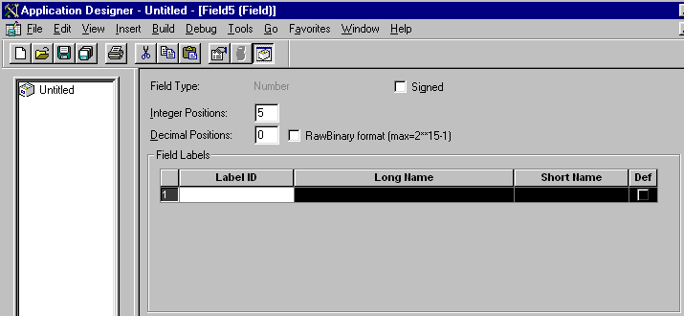
Creating Field Definitions

Slide 22
Translate Values: till char 4
Table PSXLATITEM

Slide 23
Activity:
New Fields:
  BRANCH_ID : For School Branch. Char size 5
  STD_ID : For Standard. Number size 2
  DIV_ID : For Division . Char size 1 with Xlat : A, B, C, D
  STUDENT_ID : For Student Roll # . Number Size 2

Slide 24
Creating Record Definitions

Slide 25
A database for a PeopleTools application contains three major sets of tables:
System Catalog tables store physical attributes of tables and views, which your database management system uses to optimize performance.
PeopleTools tables contain information that you define using PeopleTools.
Application Data tables house the actual data that your users enter and access through PeopleSoft application pages.

Slide 26
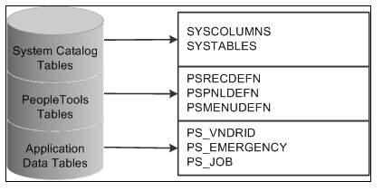
This figure shows PeopleSoft database tables and sample names:

Slide 27
Few Important Fields
Effective Dates
Effective dates enable you to keep historical, current, and future information in tables. You can use the information to review the past and plan for the future. There are three types of effective dates:
Future
Data rows that have effective dates that are after the system date, which is usually today’s date.
Current
Data row with the most recent effective date that is closest to today’s (system) date, but not a future date. Only one row is the current row.
History
Data rows that have effective dates before the current data row.

Slide 28
Application Development Steps (cont…)
Create record definitions
Fields that are grouped together as a unit are record definitions.
PeopleTools-based applications are table-based systems.
When creating a record definition, you are actually defining two layers of information: the record level and the field level.
At the record level you determine the structure of the database table and the ultimate purpose of the record definition as well as how it will be used in the system.
At the field level, you determine the characteristics of the fields and any online processing that you want to occur behind the scenes when a user enters data.

Slide 29
Creating Record Definitions
Creating a New Record Definition
Fields that are grouped together as a unit are record definitions. A record definition represents what the underlying Structured Query Language (SQL) database tables look like and how they process data.

Slide 30
Creating Record Definitions
Viewing Record Definitions
You can see four views of the record by selecting View from the main toolbar:
  Field Display
  Use Display
  Edits Display
  PeopleCode Display

Slide 31
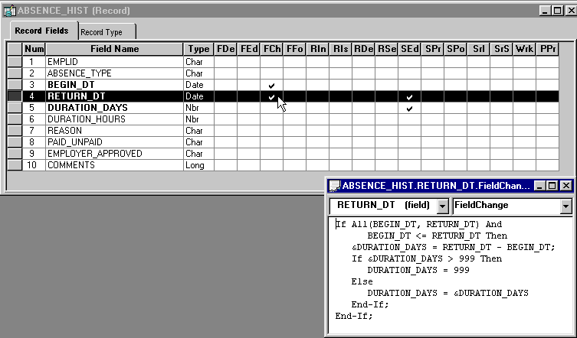
Creating Record Definitions
Viewing PeopleCode Program Types

Slide 32
Record Type
Record Type tab to define the type of record definition.
SQL Table (Structured Query Language table)
Record definition has a corresponding physical SQL table in the database..
SQL View (Structured Query Language view)
Record definition corresponds to a SQL view, which is not a physical SQL table in the database, but rather fields from one or more SQL tables that are reorganized into a different sequence. This provides an alternate view of information that is stored in tables.
To create the SQL view, click the Click to open SQL Editor button, enter a SQL Select statement, and then run the Build process.

Slide 33
Dynamic View
Record definition can be used like a view in pages and PeopleCode, but is not actually stored as a SQL view in the database. Instead, the system uses the view text as a base for the SQL Select that is performed at runtime. Dynamic views can provide superior performance in some situations, such as search records and in PeopleCode Selects, because they are optimized more efficiently than normal SQL views.
Note. Keys for dynamic views should not be effective date fields.
The dynamic view should contain only fields whose names match exactly the fields comprising the SQL query.
Derived/Work
Select to define the record definition as a temporary workspace to use during online page processing. A derived or work record is not stored in the database, so you do not build it.

Slide 34
SubRecord
Select to define the record definition as a subrecord—a group of fields that are commonly used in multiple record definitions—that you can add to other record definitions. This way, you can change a group of fields in one place, as opposed to changing each record definition in which the group of fields is used.
Query View
Select to define the record definition as a view that is constructed using the PeopleSoft Query tool. Before you can create the view, PeopleSoft Application Designer prompts you to save the definition.

Slide 35
Temporary Table
Record definition as a temporary table. Temporary images of the table can be specified on the PeopleTools Options page. Temporary tables are used for running PeopleSoft Application Engine batch processes. Temporary tables can store specific data to update without risking the main application table.
Non Standard SQL Table Name (nonstandard Structured Query Language table name)
Specify the SQL table name that you are defining, to override the standard convention of prefixing PS_ to the record name.

Slide 36
Record Naming Conventions
PeopleSoft recommends that you adopt these naming conventions for record definition names, and use these suffixes:
_TBL : Identifies an edit or prompt table that contains data that is used for validation, as opposed to data that is maintained by the application. Prompt tables store commonly used values. They include, but are not limited to, control tables, which store company-wide values. For example, the location table (LOCATION_TBL)
_VW : Identifies a record definition that is physically implemented by defining a SQL view.
_DVW : Identifies a dynamic view.
_WRK : Identifies derived work records.
_SBR : Identifies subrecords.
_QVW : Identifies a query view.

Slide 37
AUDIT_ : Identifies record definitions that store audit information for other record definitions in the database.
FUNCLIB_ : Identifies record definitions that contain written PeopleCode functions, as opposed to built-in functions. You can include these records in the component and call them as functions. These self-developed functions are generally located in FieldFormula events, and the records are usually derived.
DERIVED_ : Identifies shared record definitions (across an application module or group) that have fields for PeopleCode events.
WEBLIB_ : Identifies record definitions that store internet scripts. Internet scripts are generally located in FieldFormula PeopleCode events. You must grant access in the Security component for a WEBLIB record with an internet script before it can be run in a PeopleCode program.
R_ :Identifies work record definitions for Structured Query Report reports. The remainder of the record name consists of the program or report ID.
_WL :Identifies the record as a worklist record definition.
_AET: State Record

Slide 38
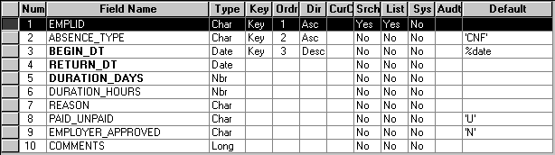
Creating Record Definitions
Understanding Record Key Considerations

Slide 39
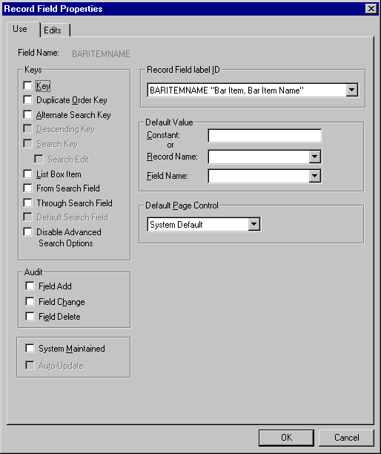
Record Properties
Setting Record Field Use Properties

Slide 40
Audits
Audit Options
While you can audit individual fields at the field level, you might find it more efficient to have the system audit the entire row whenever a user adds, changes, or deletes information. With record-level audits, the system focuses on rows of data, instead of specific fields. Consequently, a record-level audit writes a single row of audit data, rather than writing multiple rows for each insert, change, or delete transaction at the field level.
Add
Inserts an audit table row whenever a new row is added to the table underlying this record definition.
Change
Inserts one or two audit table rows whenever a row is changed on the table underlying this record definition.
Selective
Inserts one or two audit table rows whenever a field that is also included in the record definition for the audit table is changed.

Slide 41
Delete
Inserts an audit table row whenever a row is deleted from the table underlying this record definition.
Record-Level Auto-Update Options
These settings are used exclusively for mobile applications, enabling developers to display derived values on a mobile page. They are not available for subrecords
Creating User-Defined Audit Record Definitions
To audit at the record level, you must create a record definition and SQL table in which you store audit information. When you create a new audit record definition, name it with an AUDIT_ prefix.
The easiest way to create an audit table is to open the record definition that you want to audit, and save it as a new record definition, prefaced with AUDIT_. Audit record definitions can’t contain key fields. Therefore, if you clone a record definition to create an audit record definition, you must remove all key attributes.
PeopleSoft recommends that you also use the audit-specific fields that are already defined for the PeopleTools audit table (PSAUDIT), which PeopleSoft uses to track field-level audits.

Slide 42
This table lists audit field names and their purpose:
In
Audit Field Name | Purpose
AUDIT_OPRID | Identifies the user who caused the system to trigger the audits—either by performing an add, change, or delete to an audited field.
AUDIT_STAMP | Identifies the date and time the audit was triggered.
AUDIT_ACTN | Indicates the type of action that the system audited. Possible actions include: A: Row inserted. D: Row deleted. C: Row changed (updated), but no key fields changed. The system writes old values to the audit table. K: Row changed (updated), and at least one key field changed. The system writes old values to the audit table. N: Row changed (updated), and at least one key field changed. The system writes new values to the audit table.
AUDIT_RECNAME | Identifies the name of the record definition that was audited.

Slide 43
Activity:
New Table for
  SCHOOL_BRNCH : with fields BRANCH_ID, DESCR
  SCHOOL_BRNCH_DTL : with fields BRANCH_ID, DESCR
  BRNCH_STD : with fields BRANCH_ID, STD_ID
  BRNCH_STD_DIV: with fields BRANCH_ID, STD_ID, DIV_ID
  STUDENT_DTL : with fields BRANCH_ID, STD_ID, DIV_ID , STUDENT_ID , FIRST_NAME, LAST_NAME

Slide 44
Understanding the Build Process

Slide 45
Application Development Steps (cont…)
Building the Tables
Once you define the record definition you must create or build the underlying SQL tables that house the application data that your users will enter online in the production environment.
This Build process is the centerpiece of the data administration features in PeopleSoft Application Designer.
The build process takes all of the properties of a record definition and creates a database table from it. Unless this step is taken, there is no table in the database to accept application data.

Slide 46
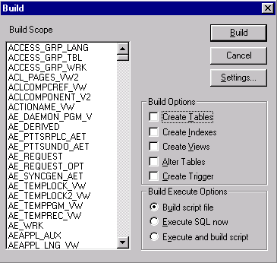
Understanding the Build Process
Access all of the commands and options that are associated with building tables, views, indexes, triggers, and altering tables from the Build menu.
When you choose to build an item from the Build menu, the tasks for creating or running SQL scripts that define the underlying database components are included in the Build dialog box.

Slide 47
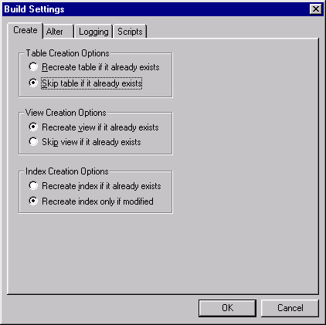
Understanding the Build Process
The settings for the Build process on the Build Settings dialog box enable you to configure various aspects of the process. Depending on which build option you are running, your settings vary.
When you select the Create Tables, Create Views, or Create Indexes options in the Build dialog box, specify the appropriate options on the Create tab of the Build Settings dialog box such as if you need to specify whether an existing table, view, or index is skipped or dropped and re-created.

Slide 48
Activity:
Build the Records:
  SCHOOL_BRNCH
  SCHOOL_BRNCH_DTL
  BRNCH_STD
  BRNCH_STD_DIV
  STUDENT_DTL

Slide 49
Creating Page Definitions

Slide 50
Application Development Steps (cont…)
Creating Page Definitions
Pages are the user interface for the application where you present the data to the users and enable them to enter data into the application data table created in the previous step.
In this step you add page controls to a page and that you associate with record fields and configure the display of the page. The page is presented to the user in a browser window as HTML.

Slide 51
Processing Modes:
Interactive :
  Trip to the server.
  A transmission to the application server is performed to run that field-level event.
  The page is displayed again.
  Processing time increase.
Deferred :Deferred mode enables you to defer many of the conditions that need server processing until running them on the application server is required or requested.
  You can select deferred mode processing at the field, page, and component levels.
  For a field in the component to run in deferred mode, you must select deferred mode at each of those levels.

Slide 52
Page Controls
Charts.
Frames.
Group boxes.
Horizontal rules.
Images.
Static text.
Check boxes.
Drop-down list boxes.
Edit boxes and long edit boxes.
Radio buttons.
Popup pages.
Subpages.
Secondary pages.
Push buttons or links.
HTML areas.

Slide 53
Level Based Controls:
The three level-based controls are:
Grids Scroll areas Scroll bars
There are four levels in level-based controls: Level 0, Level 1, Level 2, and Level 3. These levels are referenced as occurs levels on the Record tab in the page field properties for the level-based control that you are setting.
Level 0 : This is the nonscrolling area that directly relates to the key information of the underlying record. Level 0 information is usually display-only with data that the user entered on the initial search page.
Levels 1−3 : These levels include the scrolling data that is related to the Level 0, nonscrolling data. Level 1 is subordinate to Level 0; Level 2 is subordinate to and nested in Level 1; and Level 3 is subordinate to and nested in Level 2. You can nest level-based controls up to 3 levels.

Slide 54
Types of Pages :
Standard : The standard page that you see in portal.
Secondary : While a secondary page is just another page to the user at runtime, they look and behave differently than the primary pages. For example:
  You can view a secondary page from its primary page only.
  A secondary page should have OK and Cancel buttons so that the user can dismiss the page (accepting or canceling input) and return to the primary page.
  There are two ways to associate a secondary page with a primary page:
    Insert a push button or link and associate it with your secondary page.
    Insert a secondary page control.
    When you use a secondary page control, you must also insert a command push button on the page and call the DoModal PeopleCode function from the FieldChange event for the push button to display the secondary page.
Subpage: Commonly used page functionality in your application. Rather than duplicating the same set of page fields on two or more pages, you can create a single subpage that contains those page fields and add it to any page.

Slide 55
Activity:
New Page:
SCHOOL_DETAILS:
  Lvl – 0 SCHOOL_BRNCH_DTL: with fields BRANCH_ID (prompt SCHOOL_BRNCH ), DESCR
  Lvl – 1 Scroll : BRNCH_STD : with fields STD_ID
  Lvl – 2 Scroll : BRNCH_STD_DIV : with fields DIV_ID
  Lvl – 3 Grid : STUDENT_DTL : with fields STUDENT_ID , FIRST_NAME, LAST_NAME

Slide 56
Creating Component Definitions

Slide 57
Application Development Steps (cont…)
Creating Component Definitions
Component definitions represent complete business transactions in PeopleSoft applications and are central to navigation and security access. A component holds one or more pages that the user navigates between using tabs or links. Here you define the search record and search attributes, processing mode, and toolbar buttons that display at the bottom of each page in the component.

Slide 58
Creating Component Definitions
A component represents a complete business transaction. It comprises either a single page or a set of pages that are meant to be processed as one. After you create pages, you add them to one or more components to access them through menus or in business processes.
To create a new component definition:
  With a new or existing project open in PeopleSoft Application Designer, select File, New
The component definition window has two tabs, Definition and Structure, that provide different views of a component.
  Definition Tab
  Structure Tab

Slide 59
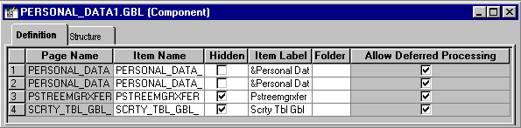
Creating Component Definitions
Definition Tab

Slide 60
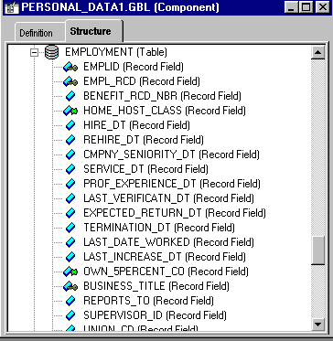
Creating Component Definitions
Structure Tab

Slide 61
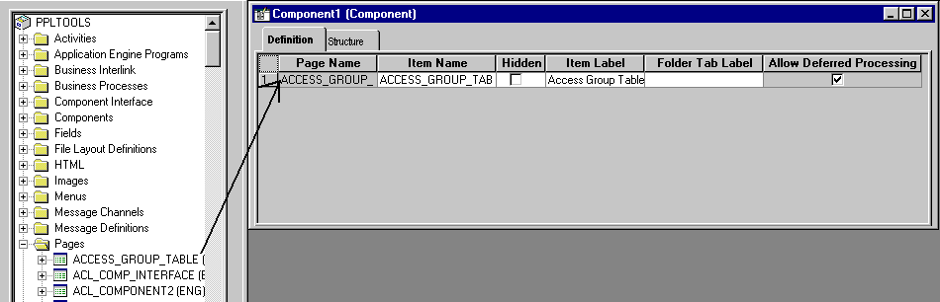
Creating Component Definitions
Adding Pages to Components
  Use the Insert menu to add a page.
  Drag a page into the component.

Slide 62
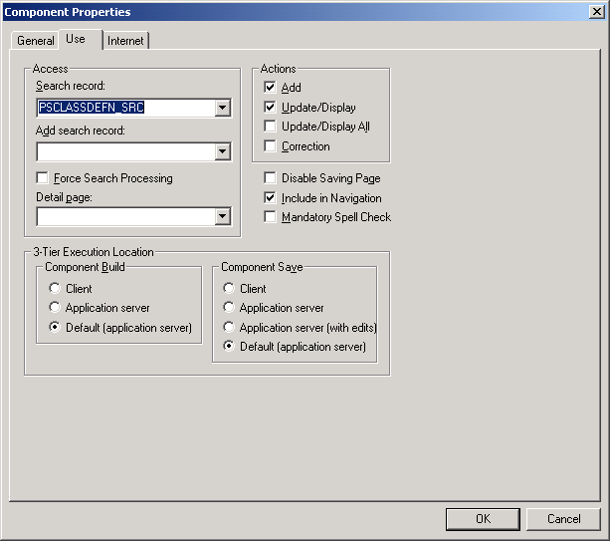
Creating Component Definitions
Setting Component Properties
In the Component Properties dialog box, specify the update and data entry actions; on the Use tab, specify the search record information. You can also save notes about the component on the General tab.

Slide 63
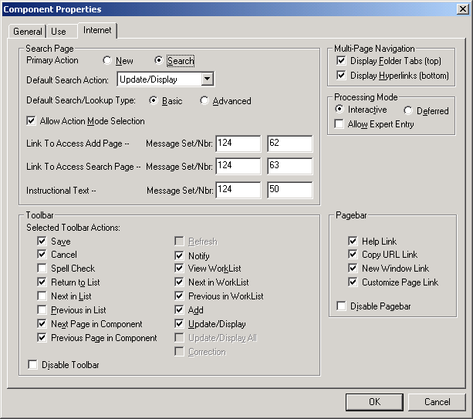
Creating Component Definitions
Setting Internet Properties

Slide 64
Activity:
New Component:
  SCHOOL_DETAILS
    With the page SCHOOL_DETAILS

Slide 65
Creating Menu Definitions

Slide 66
Creating Menu Definitions
A menu is a logical grouping for assigning security to your system. You create a menu as a placeholder for components. After you save your menu, use the Registration Wizard to assign components and security.
You can create two types of menus using PeopleSoft Application Designer:
  Custom (component) menus provide an internal reference for components and pages. They are grouped logically into menu groups to assign security. They are not used for navigational purposes.
  Pop-up menus appear when a user clicks a pop-up button.

Slide 67
Using the Registration Wizard

Slide 68
Using the Registration Wizard
After you create your pages and assign them to a component, you can register that component to display the transaction page in the browser. You can do this using the Registration Wizard.
The wizard gathers information, then attaches the component to a menu, assigns a permission list to allow security access rights, and places a content reference entry in the portal registry, which displays the component to the user on the navigation menu.

Slide 69
Application Development Steps (cont…)
Registering the Component
The Registration Wizard makes registering a component easy. In this step you accomplish several things: attach the component to a menu, assign security access for users, and place navigational links in the registry. Once you register a component, the user interface is complete and you can view the application in the browser.

Slide 70
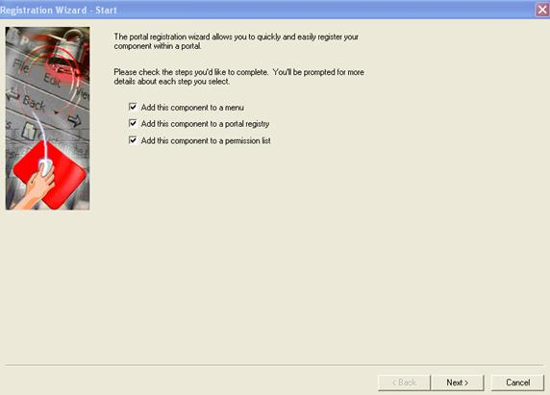
Using the Registration Wizard

Slide 71
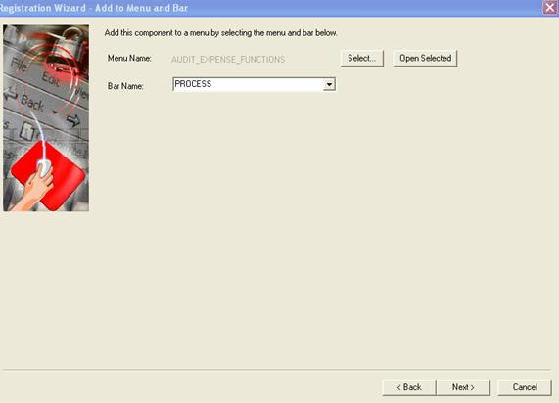
Using the Registration Wizard

Slide 72
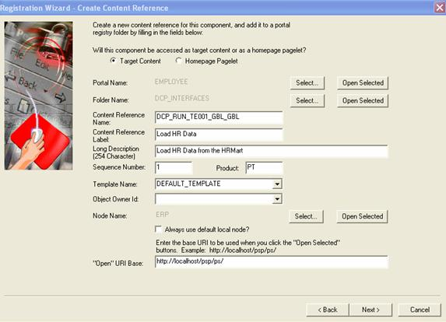
Using the Registration Wizard

Slide 73
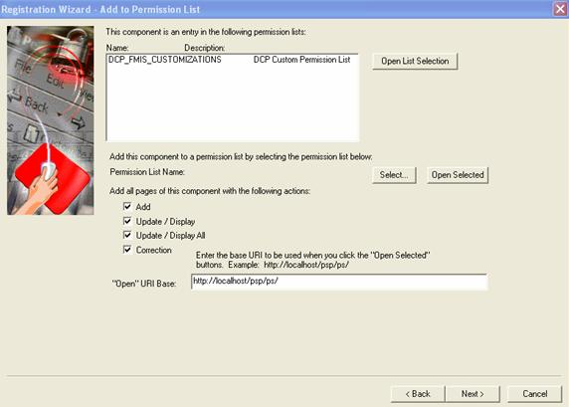
Using the Registration Wizard

Slide 74
Application Development Steps (cont…)
Testing the Application
The final step of application development is to thoroughly test the application before delivering the finished product to users. It is important to test all aspects of the application by opening the transaction in your browser and entering test data into the application. As issues arise you can cycle back through each of these steps to resolve them.

Slide 75
Constructing File Layouts

Slide 76
Constructing File Layouts
A file layout is a definition that represents the data structure of a flat (text) file to be processed. When reading from or writing to a flat file, the PeopleCode can use a file layout as a template to identify and correctly process the file’s records and fields. File layouts work with hierarchical and nonhierarchical data, and they can handle files that combine data records with nondata (audit or control) records.

Slide 77
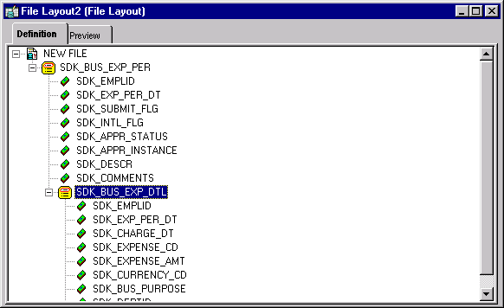
Constructing File Layouts
Creating a New File Layout Definition
In PeopleSoft Application Designer, select File, New, File Layout
A new file layout contains only one element—the root node, to which file records are attached. The default root node name is NEW FILE.
Save the new file layout definition. You’re prompted to name the file layout, which also becomes the name of the root node.

Slide 78
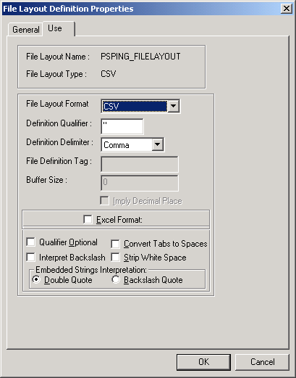
Constructing File Layouts
File Layout Properties
The General tab of the dialog box contains description information for the file layout.
The Use tab contains specific information for the file layout.

Slide 79
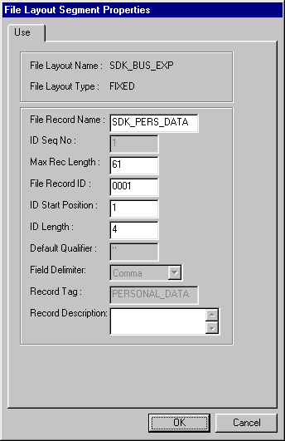
Constructing File Layouts
File Record Properties
The File Layout Segment Properties dialog box contains information that is stored at the file record level.
Access the dialog box by using one of the following methods:
  Double-click the file record node.
  Right-click the file record node, and select Selected Node Properties.

Slide 80
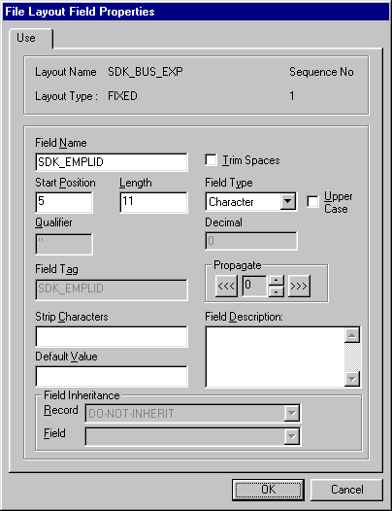
Constructing File Layouts
File Layout Field Properties
The File Layout Field Properties dialog box contains information that is stored at the file field level.
Access the dialog box by using one of the following methods:
  Double-click the file field node.
  Right-click the file field node, and select Selected Node Properties.

Slide 81
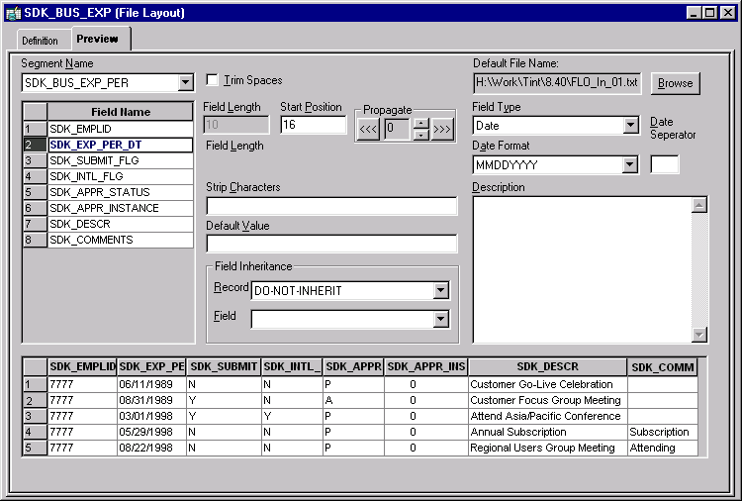
Constructing File Layouts
Previewing Input Data
In PeopleSoft Application Designer, select File, New, File Layout, Preview.

Slide 82
Copying Projects

Slide 83
Copying Projects
Understanding Project Copy Options
There are two ways to copy projects to another database:
  Copying a source project directly to a target database to which you are connected.
  Copying a source project to a file and then copying the file to a target database.

Slide 84
Copying Projects
Copying Projects to a Target Database
  (Optional) Lock target database definitions.
  Deactivate all system tracing.
  Select Tools, Copy Project, To Database from the PeopleSoft Application Designer toolbar.
  Sign in to the target database as you do with any PeopleSoft database.
  In the Copy dialog box, specify the types of definitions to copy and start the Copy process.
  (Optional) Select the Reset Done Flags check box.
  (Optional) Select the Copy Project Definition check box.
  Select the definition types to copy.
  Click Copy.
  After the copy completes, check for messages.
  Stamp the database.

Slide 85
Copying Projects
Copying a Project to a File
  Open the project that you want to copy.
  Select Tools, Copy Project, To File.
  The Copy File dialog box appears.
  Click Copy.

Slide 86
Copying Projects
Copying a Project From a File
  Select Tools, Copy Project, From File.
  Browse to locate the project file or select the file from the Projects list.
  Select the project from the projects list by clicking Select or double clicking the project name.
  Select whether to use the project definition from the file or the database, and click OK.
  Select the definition types to copy.
  The Definition Type(s) list shows the definition types that have been exported and are available to be copied into the database.
  Select the Override Pre-Requisites check box if required.
  Click Copy.

Slide 87
Application Designer Implementation

Slide 88
Application Designer Implementation
As part of the PeopleSoft installation process, you need to configure developer workstations (also called the PeopleTools development environment) to run successfully with your PeopleSoft system.
Need to specify one or both of the Open Database Connectivity (ODBC) setup options to run PeopleSoft Open Query.

Slide 89
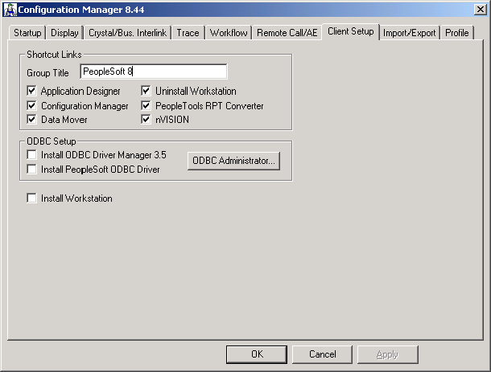
Application Designer Implementation
Use this tab to configure developer workstations and invoke the Client Setup process

Slide 90
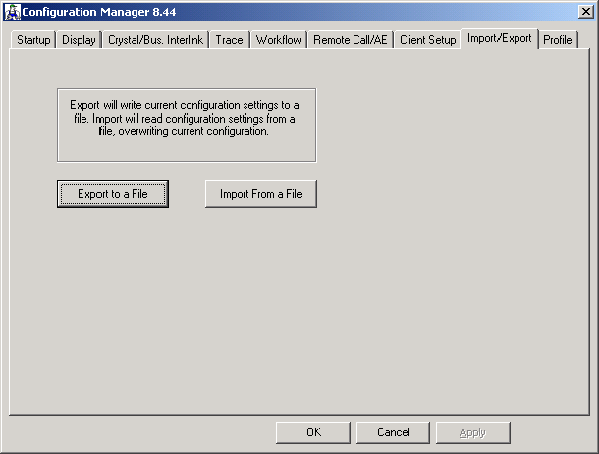
Application Designer Implementation
Use this tab to export, or save to file, the specified environment settings, and to import previously exported settings. This feature is useful when you plan to configure multiple workstations with similar settings.

Slide 91
Thank You.........!!!!!

